Slide 1
Deadlock Scenarios
How to solve Deadlock Scenarios

Slide 2
Links for this Session/Workshop
Scripts and Slide Decks https://github.com/db-berater/solving-deadlock-scenarios
ERP Demo Database (17.00 GB) https://db-berater.de/downloads/ERP_Demo_2012.bak
SQLQueryStress https://github.com/ErikEJ/SqlQueryStress
Windows Admin Center https://go.microsoft.com/fwlink/?linkid=2220149

Slide 3




Uwe Ricken db Berater GmbH
I am working with IT-systems since early 1990's and with the main focus on Microsoft SQL Server since version 6.0. I started with development of database applications in 1998 with a professional CRM-System based on Microsoft products (Microsoft Office and Microsoft SQL Server).
Since 2008 I'm focused exclusively on Microsoft SQL Server and working in 3rd level support teams for banks, insurances and global industries.
Since May 2013 I am a Microsoft Certified Master: SQL Server 2008 which was an amazing way into the depth of Microsoft SQL Server.
In July 2013 I have been awarded with the MVP Award for Microsoft SQL Server.
www: http://www.db-berater.de
email: uwe.ricken@db-berater.de
blog: http://www.sqlmaster.de
BlueSky: @sqlbambi

Slide 4
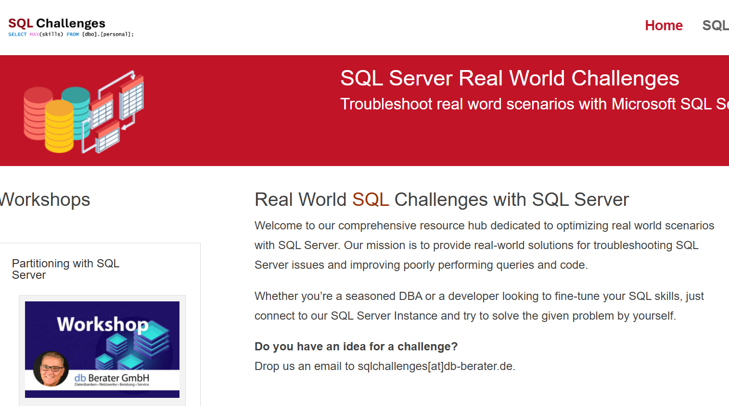
Challenge SQL Server real world scenarios
Get a challenge at least once a month
Connect to a provided SQL Server Instance
Load the challenge scenario
Try to solve it
Blog about your solution
Leave a link in the comments of the challenge to your blog post.
https://sqlchallenges.de

Slide 5
Agenda
Lock Types
Transaction Isolation Levels
Pessimistic Isolation Levels
Optimistic Isolation Levels
Deadlock Scenarios
Classic deadlock
Deadlock with referential integrity
Deadlock with only one table involved

Slide 6
Lock Types
controlling the management of concurrency

Slide 7
Lock Types
Lock Intension | Lock Type | Description
Exclusive Lock | X | This lock type, when imposed, will ensure that a page or row will be reserved exclusively for the transaction that imposed the exclusive lock, as long as the transaction holds the lock.
Shared Lock | S | This lock type, when imposed, will reserve a page or row to be available only for reading, which means that any other transaction will be prevented to modify the locked record as long as the lock is active.
Update Lock | U | this lock is similar to an exclusive lock but is designed to be more flexible in a way. An update lock can be imposed on a record that already has a shared lock. In such a case, the update lock will impose another shared lock on the target row.
Intent Lock | I (X/S/U) | this lock is a means used by a transaction to inform another transaction about its intention to acquire a lock.
Convertion Locks
Shared w Intent exclusive | SI(X/U) | when acquired, this lock indicates that the transaction intends to read all resources at a lower hierarchy and thus acquire the shared lock on all resources that are lower in hierarchy, and in turn, to modify part of those, but not all

Slide 8
Lock Status
 | Hold Lock
Request | IS | S | U | IX | SIX | X
IS | ✓ | ✓ | ✓ | ✓ | ✓ | X
S | ✓ | ✓ | ✓ | X | X | X
U | ✓ | ✓ | X | X | X | X
IX | ✓ | X | X | ✓ | X | X
SIX | ✓ | X | X | X | X | X
X | X | X | X | X | X | X
https://learn.microsoft.com/en-us/sql/relational-databases/media/sql-server-transaction-locking-and-row-versioning-guide/sql-server-lock-conflict-compatibility.png

Slide 9
Locking Hierarchy
Object | Read Data |  | Write Data
Database | S |  | S
Table | IS |  | IX | or X with LOCK ESCALATION*
Partition | IS |  | IX | if LOCK_ESCALATION = AUTO
Page | IS | or S if the table is a HEAP | IX
Row | S |  | X
* Lock escalation in SQL Server is the process of converting many fine-grained locks (like row or page locks) into fewer coarse-grained locks (like table locks) to reduce system overhead.

Slide 10
Locking Hierarchy
HEAP / (non)clustered Index
c_custkey | c_name
10 | John
BEGIN TRANSACTION
GO
UPDATE dbo.customers
SET c_name = 'Uwe Ricken’
WHERE c_custkey = 10
IX
Partition 1
IX
PAGE
1 row
2 row
3 row
- row
- row
- row
10 row
- row
- row
X
U
Notes:
000 - Basics about relations indexes partitions allocation units pages etc.sql

Slide 11
Lock Escalation
HEAP / (non)clustered Index
c_custkey | c_name
10 | John
BEGIN TRANSACTION
GO
UPDATE dbo.customers
SET c_name = 'Uwe Ricken’
WHERE c_custkey <= 50000
IX
X
Partition 1
IX
PAGE
X row
X row
X row
X row
X row
X row
X row
11 row
- row
If to much granular locks occur, Microsoft SQL Server will lock the object itself but not the single rows!
The check for Lock Escalation happens every 1.250 rows!
1 row
2 row
3 row
- row
- row
- row
10 row
- row
- row

Slide 12
Transaction Isolation Levels
controlling the management of visibility

Slide 13
Transaction Isolation Levels
Transaction Isolation Levels in SQL Server control the visibility of data changes made by concurrent transactions
Manage, how transactions interact with each other.
There are five main isolation levels, each providing a different balance between consistency and concurrency:
Isolation Level | Dirty Reads | Phantom Reads | Non Repeatable Read
Read Uncommitted | ✓ | ✓ | ✓
Read Committed | X | ✓ | ✓
Repeatable Read | X | ✓ | X
Serializable | X | X | X
Snapshot | -- | -- | --

Slide 14

Transaction Isolation Levels

Slide 15
Deadlocks
concurrency problems that SQL Server can no longer solve

Slide 16
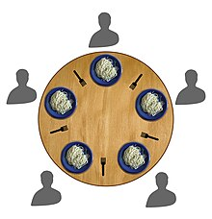
The Dining Philosophers
Dining Philosophers Problem
Five philosophers sit at a round table, alternating between thinking and eating. Each philosopher has a plate of spaghetti and a fork on either side of their plate.
To eat, a philosopher needs to use both forks. Since each philosopher shares a fork with their neighbor, there are only five forks available.
Philosophers must avoid deadlock, where each philosopher picks up one fork and waits indefinitely for the other fork to become available.
Strategies include allowing only a subset of philosophers to pick up forks at the same time, using a waiter to control access to forks, or implementing an asymmetric solution to break potential deadlocks.
This problem illustrates issues of resource allocation and synchronization in concurrent programming, highlighting challenges in ensuring deadlock-free and efficient resource sharing among processes.

Slide 17
Common Deadlock Scenarios
Object Deadlock
Range Deadlock
Implicit Deadlock
NOLOCK Deadlock
Hidden Deadlock
One Query Deadlock

Slide 18
Classic Deadlock
BEGIN TRANSACTION update_customers; GO UPDATE dbo.customers SET c_name = 'Uwe’ WHERE c_custkey = 3;
Granted
dbo.customers
lock | c_custkey | c_name | lock
 | 1 | Customer0001
 | 2 | Customer0002
 | 3 | Customer0003
 | 4 | Customer0004
 | 5 | customer0005
Granted
BEGIN TRANSACTION update_nations GO UPDATE dbo.nations SET n_name = 'UK’ WHERE n_nationkey = 2;
X
S
SELECT * FROM dbo.nations WHERE n_nationkey = 2;
Wait
dbo.nations
lock | n_nationkey | n_name | lock
 | 1 | Algeria
 | 2 | USA
 | 3 | Germany
Wait
SELECT * FROM dbo.customers WHERE c_custkey = 3;
S
X

Slide 19
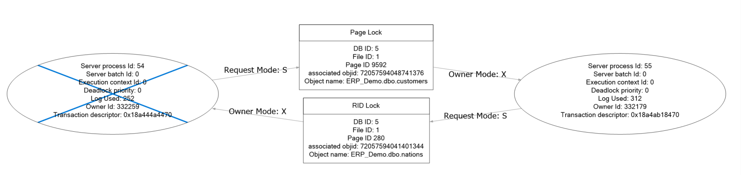
Classic Deadlock

Slide 20
Classic Deadlock

Slide 21
Foreign Key Deadlock
n
1
dbo.customers
c_custkey | c_name | c_nationkey
1 | Customer0001 | 3
2 | Customer0002 | 1
3 | Customer0003 | 8
4 | Customer0004 | ...
5 | customer0005 | …
dbo.nations
lock | n_nationkey | n_name | req
 | 1 | Algeria
 | 2 | USA
 | 3 | Germany

Slide 22
Foreign Key Deadlock
BEGIN TRANSACTION update_customers; GO UPDATE dbo.customers SET c_name = 'Uwe’, c_nationkey = 99 WHERE c_custkey = 3;
dbo.customers
lock | c_custkey | c_name | lock
 | 1 | Customer0001
 | 2 | Customer0002
 | 3 | Customer0003
 | 4 | Customer0004
 | 5 | customer0005
BEGIN TRANSACTION update_nations GO DELETE dbo.nations WHERE n_nationkey = 99;
Granted
X
S
Wait
SELECT * FROM dbo.nations WHERE n_nationkey = 99;
dbo.nations
lock | n_nationkey | n_name | lock
 | 1 | Algeria
 | 2 | USA
 | 3 | Germany
 | 99 | Any
Wait
Granted
S
Granted
S
X

Slide 23
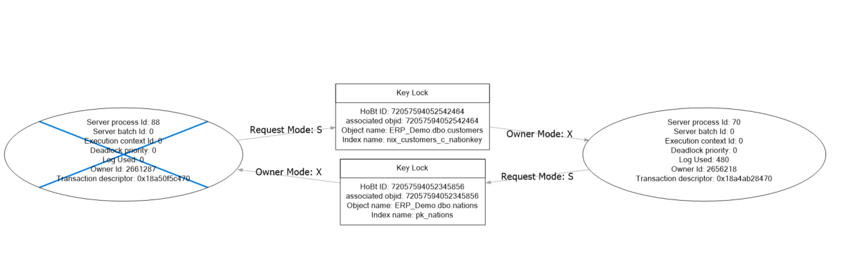
Foreign Key Deadlock

Slide 24
Foreign Key Deadlock

Slide 25
Index Key Deadlock
dbo.process_status (HEAP)
lock | Id | scancode | ship_id | is_state | lock
 | 1 | 000000000 | 4711 | 0
 | 2 | 000000001 | 6870
 | 3 | 000000001 | 6987
 | 4 | 000000002
 | 5 | …
UPDATE dbo.process_status
SET istate = 1
WHERE scancode = @scancode
AND ship_id = @ship_id;
X
/* Create a nonclustered index on the predicate attributes */
CREATE NONCLUSTERED INDEX nix_process_status_scancode_ship_id
ON dbo.process_status
(
scancode,
ship_id
);
GO
nix_process_status_scanncode_ship_id
lock | scancode (key) | ship_id (key) | RID Key | lock
 | 000000000 | 4711 | 0
U

Slide 26
Index Key Deadlock

Slide 27
https://github.com/db-berater/solving-deadlock-scenarios

